Slide 1
Diet recommendation system
By Satya Ranjan Panda & Arnab Sarma

Slide 2
Contents
Definition of Diet Recommendation System
Control Flow Diagram
System Requirements
Concept of the system
Result
Conclusion

Slide 3
Definition
In nowadays world consumption of fast food has become some time necessity but we need to control our diet and have a good balanced diet that will help and keep both our body and mind healthy. This machine learning system is built with in mind for the normal people who wants to maintain, gain or to lose weight.
Use of mobile and web-based applications for diet and weight management is currently increasing. However, the impact of known apps on clinical outcomes is not well-characterized so far. Moreover, availability of food recommendation systems providing high quality nutritional advices to both healthy and diet-related chronic diseases users is very limited. In addition, the potentiality of nutraceutical properties of typical regional foods for improving app utility has not been exerted to this end.

Slide 4
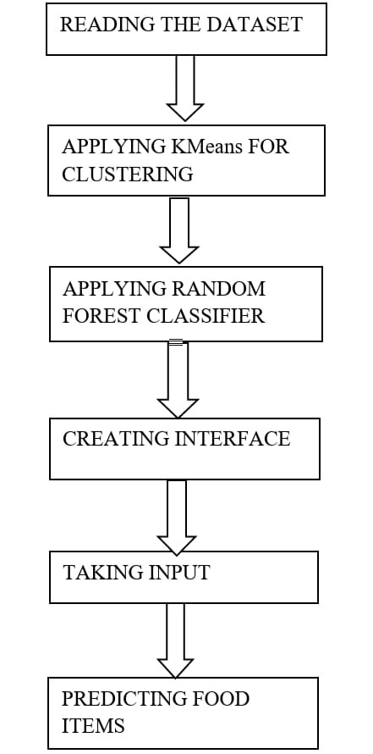
Control flow diagram

Slide 5
System requirements
Hardware Requirements :
Ram 2GB
STORAGE 1GB
32 OR 64 BIT SYSTEM
SOFTWARE REQUIREMENTS :
PYTHON 3.5 OR HIGHER
VS Code

Slide 6
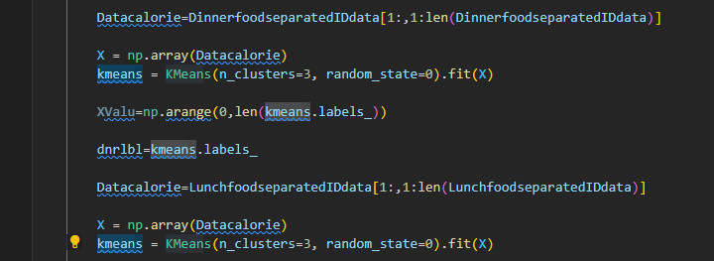
Concept of the system
Applying KMeans for clustering on Lunch data, Breakfast data, Dinner data into clusters and after taking random K points with which it assign each data point to their closest centroid, which will form the predefined K clusters and calculate the variance and place a new centroid of each cluster.

Slide 7
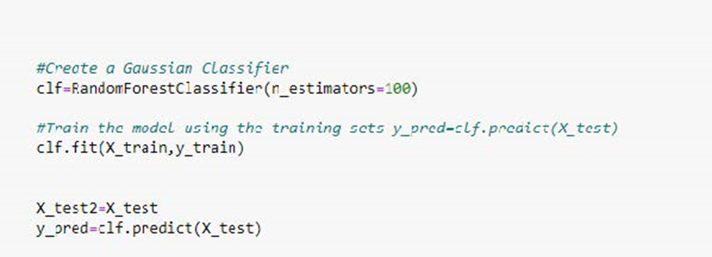
Using random forest classifier to create decision trees from the clusters and then give the prediction from each of them and finally selects the best solution by means of voting.

Slide 8
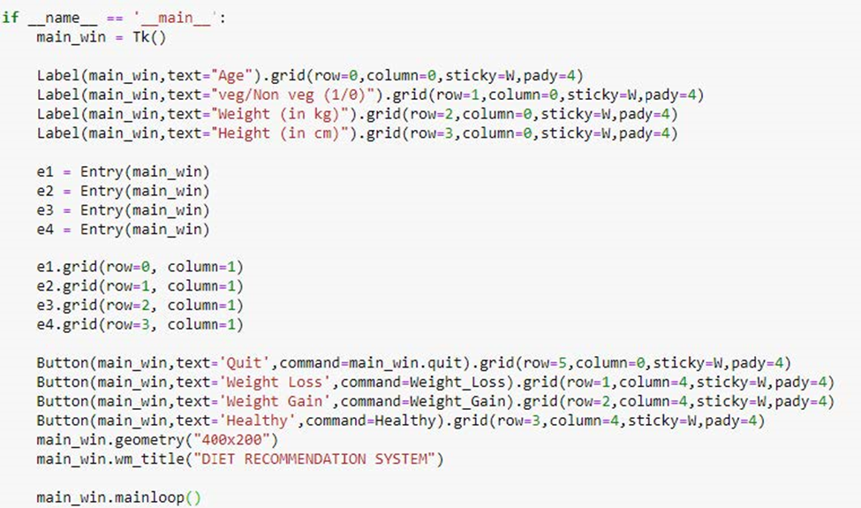
Using numpy and tkinter to create a user interface to give inputs

Slide 9
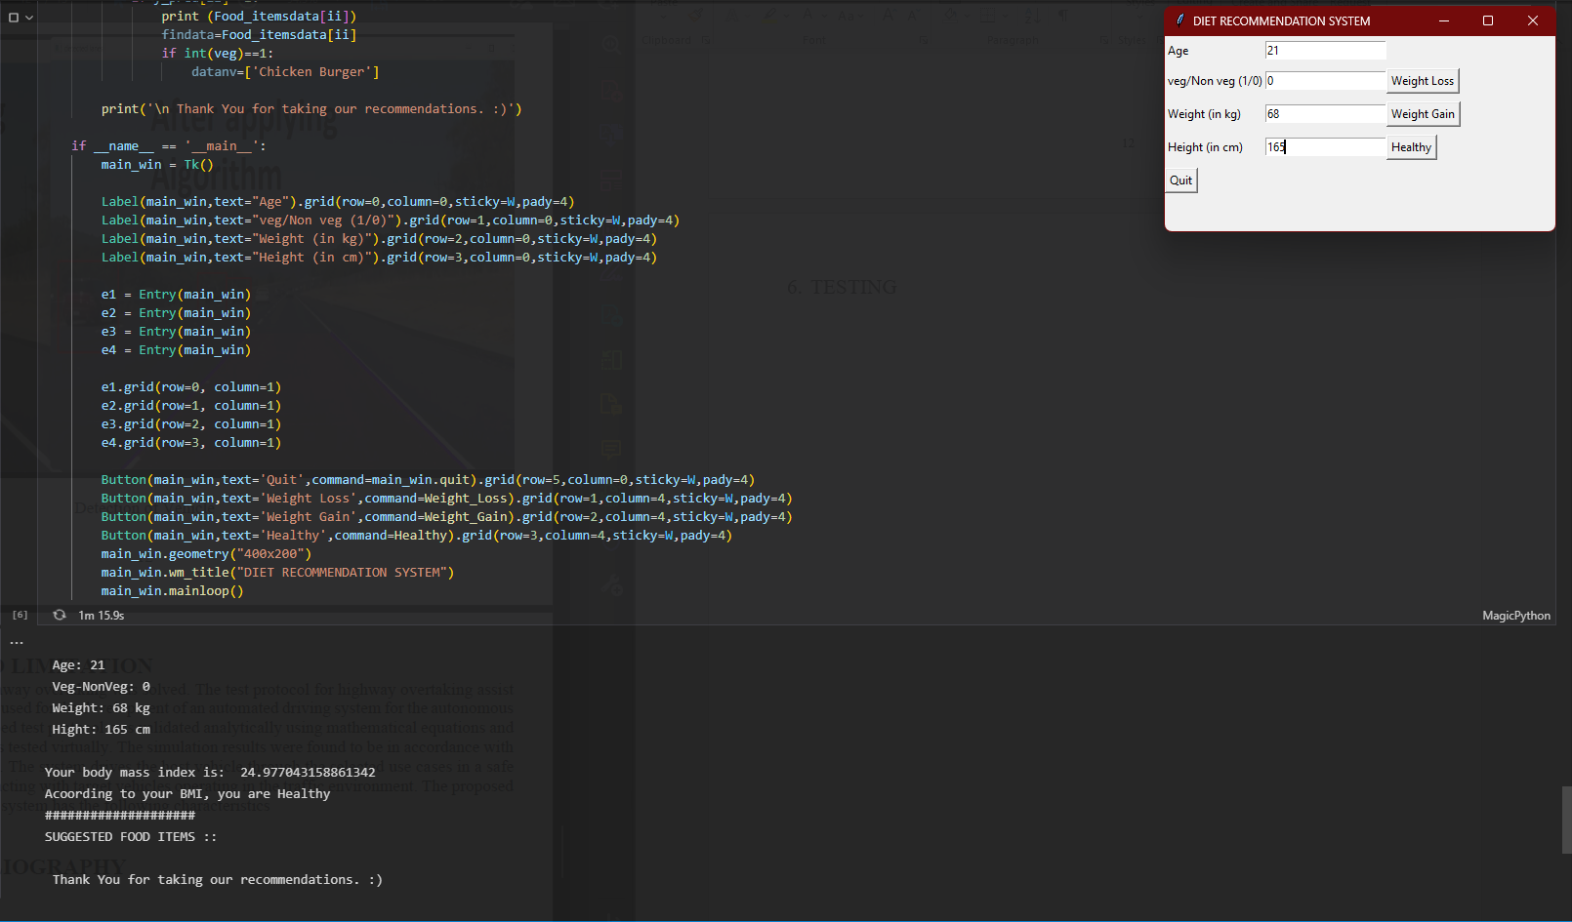
Result

Slide 10
Conclusion and limitation
If this diet recommendation system is properly designed, implemented and finally evaluated, it could be used as an effective tool to improve nutrition and promote a healthy lifestyle. This can help to inform specialists in the nutrition informatics domain, which was necessary to design and develop DRS. In general, all food recommender systems play a vital role in providing food items meeting preferences and adequate nutritional needs of users as well as persuading them to comply positive eating behaviors. Some challenges regarding user information, recommendation algorithms, changing eating behaviors, explanations provision, and group decision making are discussed as issues for further work. Its limitations currently is due the lack of data on the extremely vast food variations and its relational data.

Slide 11
Thank you

